Slide 1





An Introduction to + Express
Keith Chester
thekeithchester
hlfshell
keithchester

Slide 2

Who the heck am I
Head of Research and Development + and an Application Developer at
I use node.js everyday for websites, tablet apps, robots, hardware control, heart rate monitoring, light control, sound effects, beer measuring, nerf wars, video games, computer vision, augmented reality, image manipulation, home automation, wifi tracking, microservices, e-mail handling, chat bots, artificial intelligence, streaming video, big data, drink mixing (really), beach selfies…
and much more

Slide 3
Welcome to the community
node.jSTL meets at least once a month
We try to make talks good for experts and beginners
Open floor time to talk to experts, ask for help on projects, get resources to learn
“Classes” like this is new, and we’d like your feedback to have more
jSTL coming soon!
General Javascript meetup to incorporate ALL front end frameworks + node
Work in progress
Join STL-Tech slack! stltech.herokuapp.com to get an invite
#node channel Is connected to other slack groups around the world
@keithchester is my username there

Slide 4
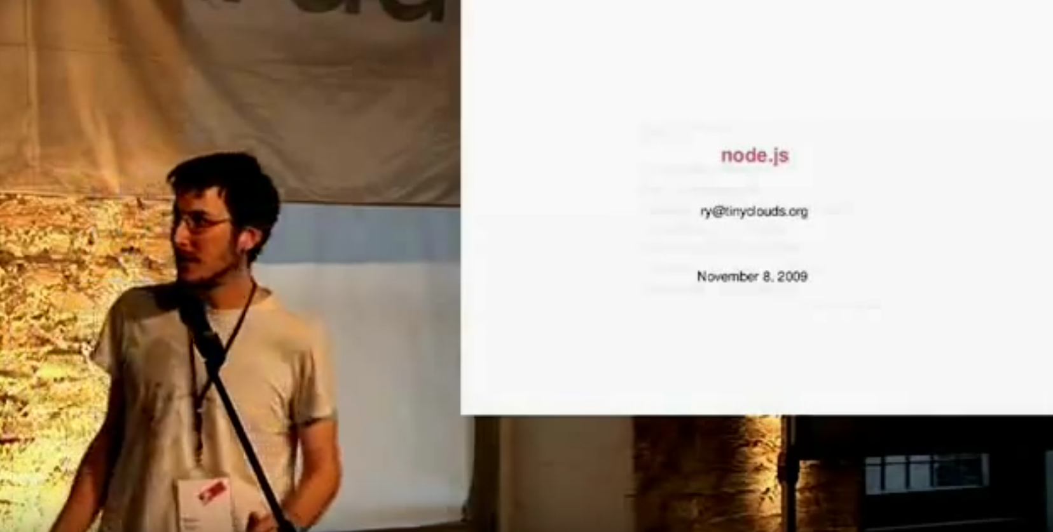
The briefest of histories
Ryan Dahl announces node.js in 2009 – a “side project” he was working on since he was unemployed. He was employed shortly after just to work on node.js

Slide 5
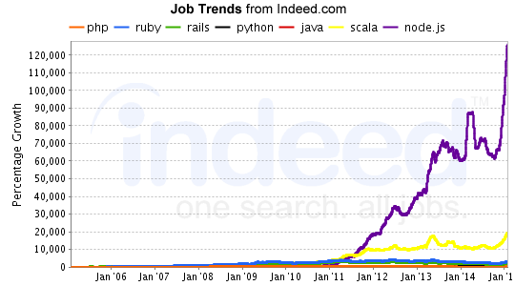
Popularity

Slide 6


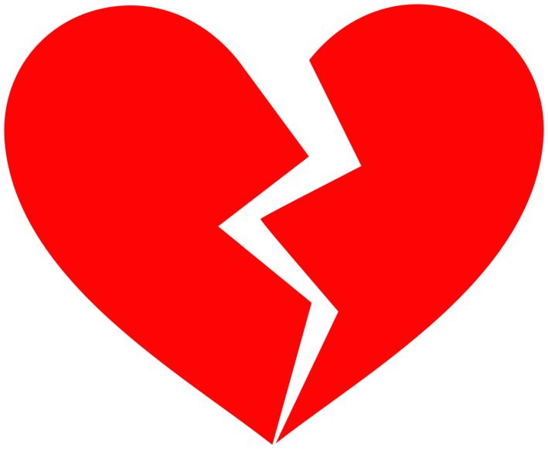
There was some messiness

Slide 7






In good company

Slide 8
node.js – the hello worlds
To the terminal!

Slide 9
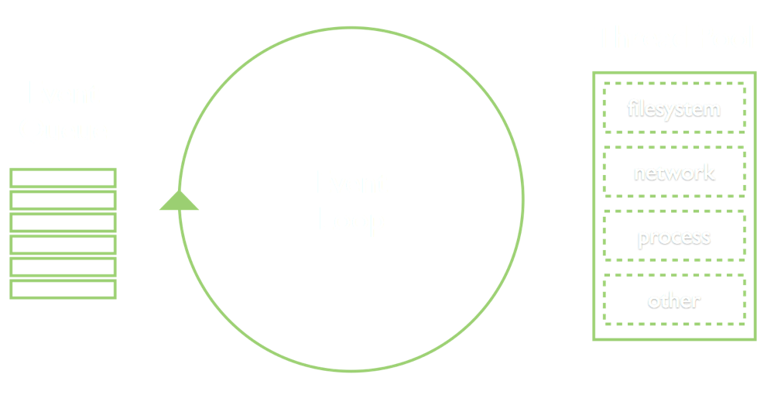
The event loop

Slide 10
The event loop
Put an example here that explains the whole asynchronous
Execution thing

Slide 11
Title
Content

Slide 12
Title
Content

